Slide 1
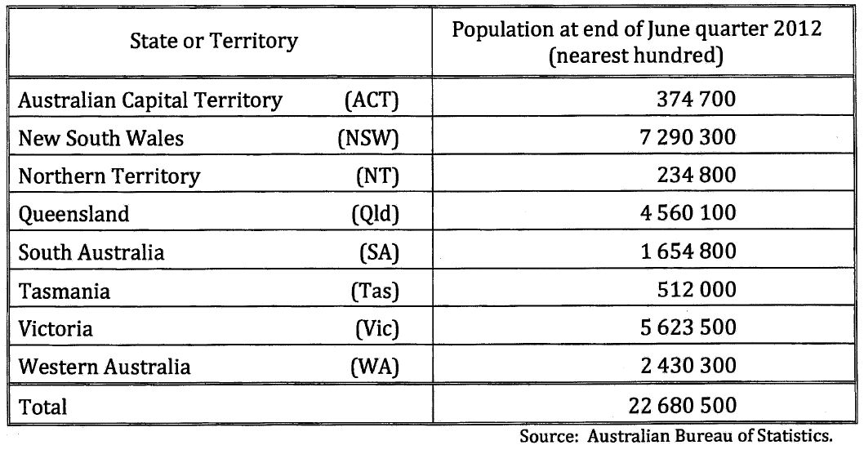
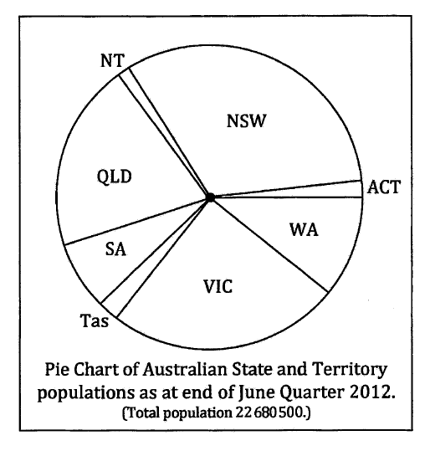
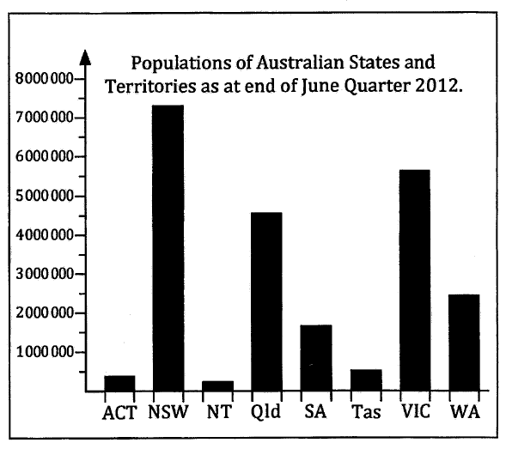
Displaying Categorical Data
In the Australian census, people were asked which state (or territory) they resided in.
This is categorical data because people would answer with a word (non-numerical).
When displaying categorical data, you would frequently use a frequency table, pie chart or bar graph.
Bar charts have the categories on the x axis and the frequency on the y axis.
They also have gaps between each bar.

Slide 2
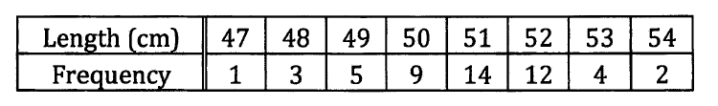
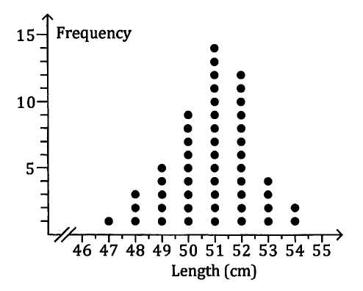
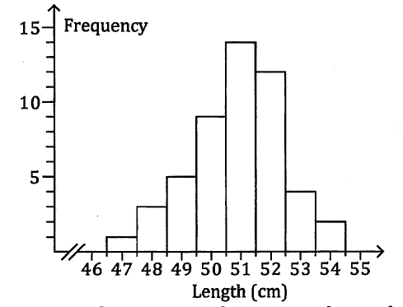
Displaying Numerical Data
The length (to the nearest cm) of 50 babies is recorded in a hospital.
Length would normally be continuous data but here it is discrete data because the answers have to be integers (due to rounding).
When displaying numerical data, you might use a dot frequency diagram or a histogram.
The discrete value is in the middle of the bar.
Note there are now no gaps between bars.

Slide 3
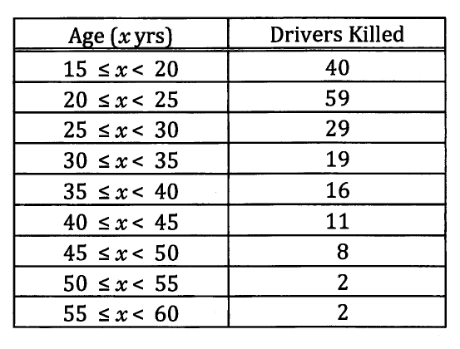
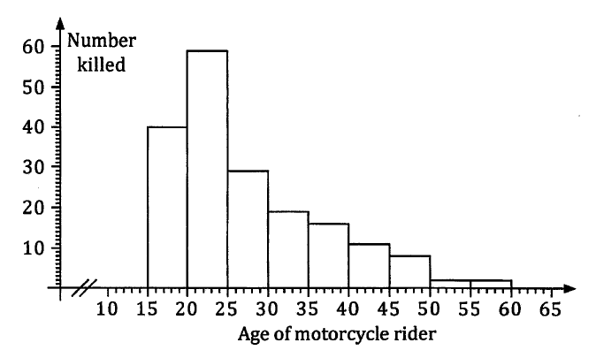
Displaying Numerical Data
A country’s motorcyclist deaths over the course of a year were recorded with the age of the motorcyclist.
Rather than having up to 45 bars on the histogram, the results were grouped.
Continuous data (and some discrete data) is usually grouped before being displayed.
The lower limit of the group is on the left hand side of the bar.
The upper limit of the groups is on the right hand side of the bar.

Slide 4
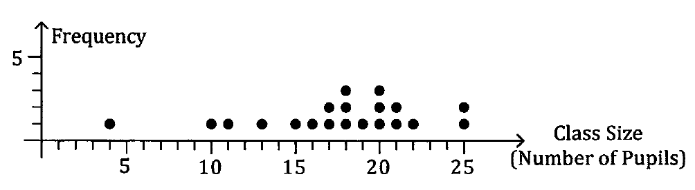
Displaying Numerical Data – Dot Frequency Diagram
Discrete data – number of pupils, not continuous.
y-axis is always frequency
x-axis is always numbers (in this case, integer)

Slide 5
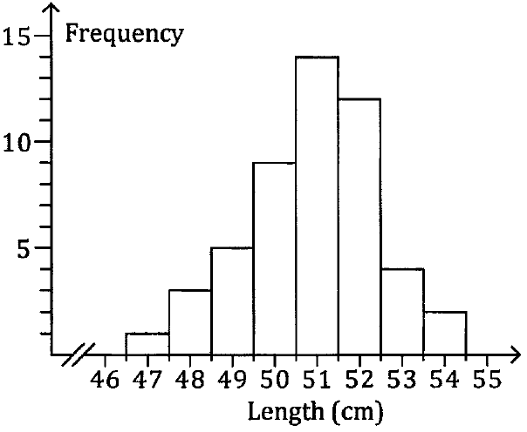
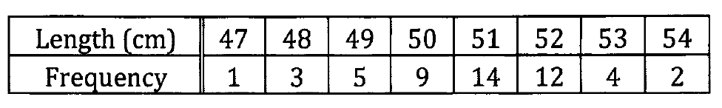
Displaying Numerical Data – Frequency Histogram
Length – usually continuous data as measured (here discrete as rounded)
50 cm – between 49.5 to less than 50.5

Slide 6
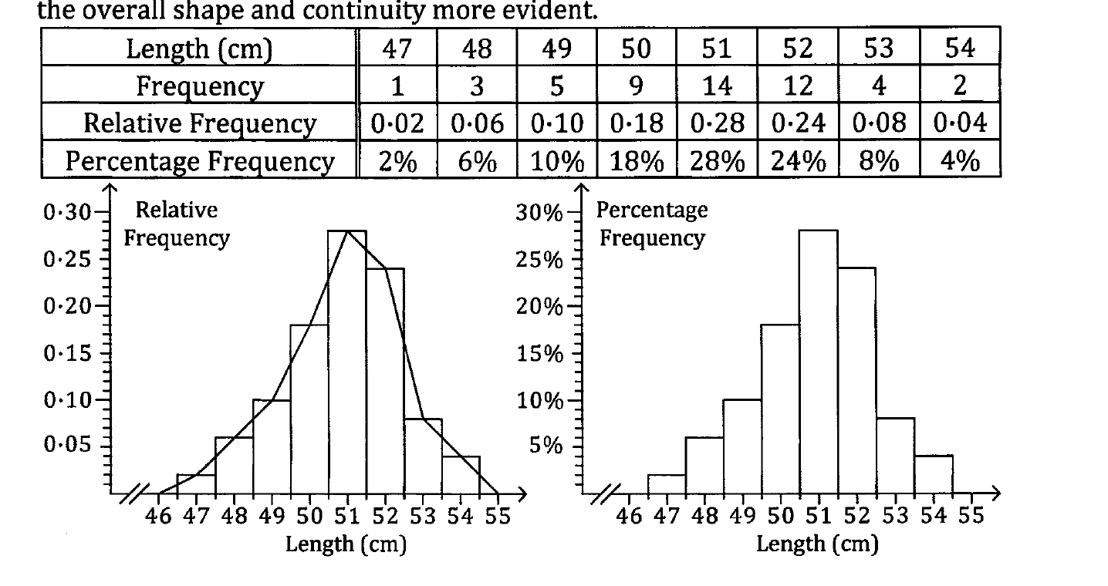
Displaying Numerical Data – Frequency Histogram
Now do 1A Q14 and 1C Q1 – 4
No gaps between the bar except when frequency = 0.
Usually have 6 – 10 equal intervals.
y-axis is always frequency, x-axis is always numbers
The frequency can be expressed in
Relative frequency – fraction of the whole
Percentage frequency – percentage of the whole
Frequency polygon – formed by connecting the middle of the top of each bar to the next, makes the overall shape more evident

